Slide 1
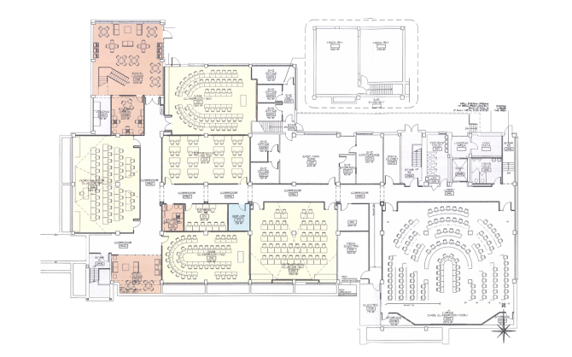






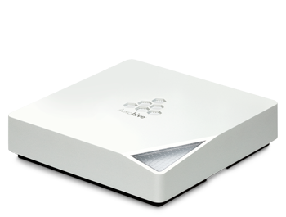
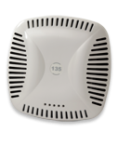
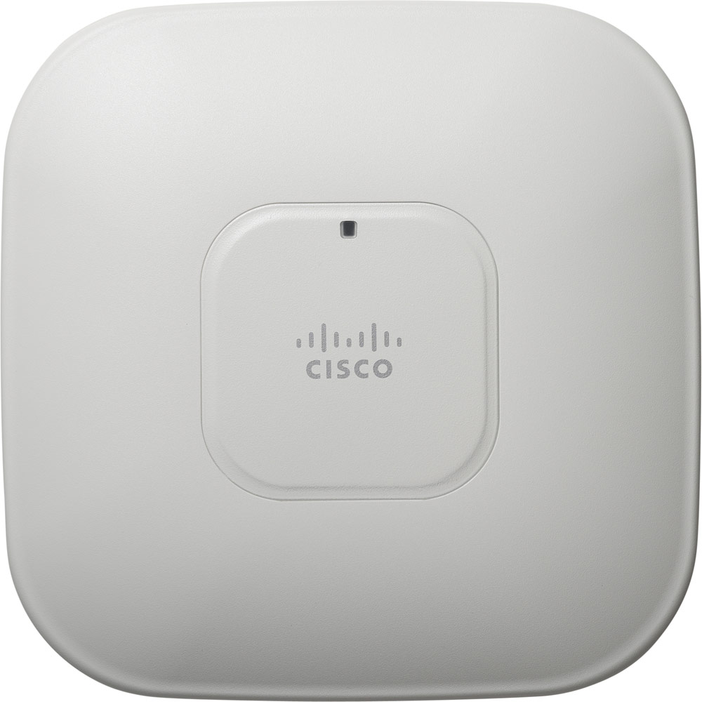
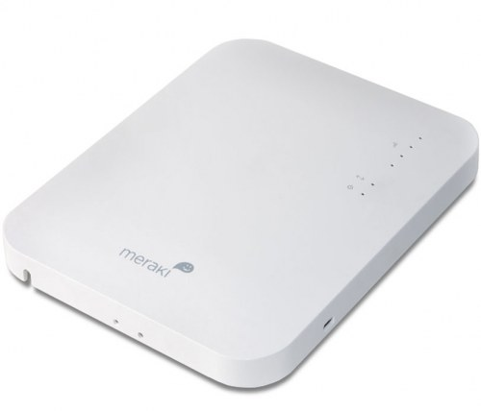
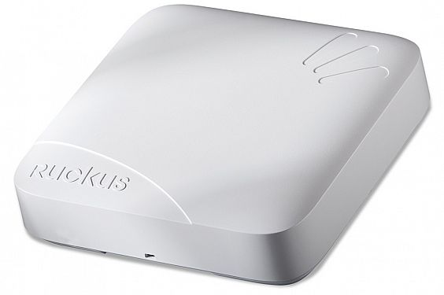
Industry’s First 3-Stream
802.11n Competitive Testing
October, 2012
Notes:
Overview presentation + detailed notes

Slide 2

Starting at the End (Key Findings)
Independent testing performed by Syracuse University
at Syracuse University (Ruckus did not pay for testing)
Ruckus worked with SU on test bed but not allowed
to influence actual testing
Wide variations between vendor claims and actual performance of 3-stream 802.11n APs (surprise, surprise)
At distance and as environment becomes difficult
(e.g. more clients, interference), AP performance degrades
Ruckus doesn’t win all tests but delivers overall best
TCP performance and client capacity

Slide 3
Test Overview
Goal: Determine real-world 3-stream AP
performance via independent testing at Syracuse
Industry’s first competitive testing of three-stream capable 802.11n enterprise APs
Three tests performed:
  Single AP, single client
  Single AP, multiple clients
  Multiple APs multiple clients
Aerohive
330
Aruba
135
Cisco
3602i
Meraki
24
Ruckus
7982

Slide 4

Overall Vendor Performances
Industry’s First 3x3:3 802.11n Competitive Testing
6%
2%
12%
14%
66%
Percentage of Vendor Test Wins
(87 tests)

Slide 5
Overall Vendor Performances
Industry’s First 3x3:3 802.11n Competitive Testing
3%
17%
32%
83%
58%
Multi-Client Tests
(12 tests)
Multi-AP Tests
(30 tests)
0%
3%

Slide 6
Test Methodology
What is it?
Testing in an environment that closely resembles
actual customer deployment and environment
Focus on most deployments are capacity-based, not coverage
Why do it?
One client/one AP does not guarantee a successful, multi-client deployment
Vendor claims ≠ actual throughput
Goals
Show real, meaningful, achievable performance

Slide 7

Cross-Test Constants
Very clean RF environment
(tests performed at night)
3-stream MacBook Pros and NETGEAR USBs dongles
IxChariot: Throughput.scr
    1MB file transfer for 2 minutes
    High Performance Throughput script for single AP tests
    10MB file transfer for 2 minutes
20MHz channel width for 2.4GHz, 40MHz for 5GHz
AP channel selection
  Single AP: ch. 1 (2.4 GHz), ch 36 (5 GHz)
  Multi AP: automated channel selection, then set manually
“Winner” determined by aggregate TCP throughput

Slide 8

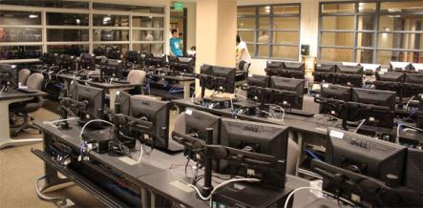

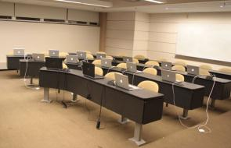
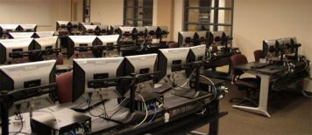
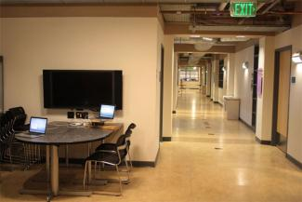
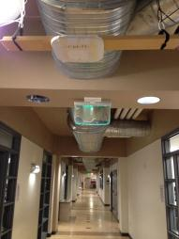
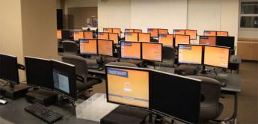
Hinds Hall

Slide 9
Wi-Fi Test Overview
Single AP, single client per radio
at various distances
  2.4 GHz, 5 GHz, 2.4 GHz and 5 GHz
  135 tests for each AP (5 locations, “3” bands, 3 orientation, up/down/bi)
Single AP, multiple clients
  One AP, three rooms, 30 clients/room
  Rooms are different distances away from AP
  2.4 GHz, 5 GHz, 2.4 GHz and 5 GHz
Multi-AP, multi-client
  1 - 4 rooms of 30 clients (120 clients)
  Channel selection, client load balancing, band steering all enabled
  Tests with and without an interfering Wi-Fi neighbor network

Slide 10
Test 1: Single AP Single Client
5 locations of varied distances and difficulties
2.4 GHz, 5GHz, simultaneous
Up/down/bi-directional
3 orientations
  = 135 (5 * 3 * 3 * 3) tests for each vendor’s AP
58’ from AP
Client locations
1
24’ from AP
AP
HINDS
HALL
4
5
3
2
40’ from AP
30’ from AP
105’ from AP

Slide 11

Single AP, Single Client Performance
Average of three discrete runs (client rotated each time) with two clients (each transmitting and receiving on different bands)
BI-DIRECTIONAL
TCP THROUGHPUT
FOR DUAL BAND CLIENTS
SHORT DISTANCE
372
368
Mbps
Location 4, 24’ (7.3M)
320
2.4 GHz
1
260
2
192
5 GHz
Ruckus
7982
Aruba
135
Cisco
3602i
Aerohive
330
Meraki
24
Notes:
One Ruckus run was 390

Slide 12
Aruba 135 vs. ZoneFlex 7982
2.4GHz
5GHz
DOWN
1 2 3 4 5
LOCATIONS
1 2 3 4 5
UP
2.4GHz
5GHz
vs.
1 2 3 4 5
1 2 3 4 5
Both
2.4GHz
5GHz
1 2 3 4 5
1 2 3 4 5

Slide 13
Cisco 3602i vs. ZoneFlex 7982
2.4GHz
5GHz
DOWN
1 2 3 4 5
LOCATIONS
1 2 3 4 5
UP
2.4GHz
5GHz
vs.
1 2 3 4 5
1 2 3 4 5
Both
2.4GHz
5GHz
1 2 3 4 5
1 2 3 4 5

Slide 14
Aerohive 330 vs. ZoneFlex 7982
2.4GHz
5GHz
DOWN
1 2 3 4 5
LOCATIONS
1 2 3 4 5
UP
2.4GHz
5GHz
vs.
1 2 3 4 5
1 2 3 4 5
Both
2.4GHz
5GHz
1 2 3 4 5
1 2 3 4 5

Slide 15
Meraki 24 vs. ZoneFlex 7982
2.4GHz
5GHz
DOWN
1 2 3 4 5
LOCATIONS
1 2 3 4 5
UP
2.4GHz
5GHz
vs.
1 2 3 4 5
1 2 3 4 5
2.4GHz
5GHz
Both
1 2 3 4 5
1 2 3 4 5

Slide 16
Single AP, Single Client Performance
BI-DIRECTIONAL
TCP THROUGHPUT
FOR DUAL BAND CLIENTS
MEDIUM DISTANCE
275
274
Mbps
Location 1 ,58’ (17.7m)
2.4 GHz
184
1
159
2
5 GHz
68
Ruckus
7982
Aruba
135
Aerohive
330
Cisco
3602i
Meraki
24

Slide 17
Single AP, Single Client Performance
BI-DIRECTIONAL
TCP THROUGHPUT
FOR DUAL BAND CLIENTS
LONG DISTANCE
228
Mbps
Location 5, 105’ (32m)
184
2.4 GHz
1
142
2
107
5 GHz
44
Ruckus
7982
Aruba
135
Aerohive
330
Cisco
3602i
Meraki
24

Slide 18
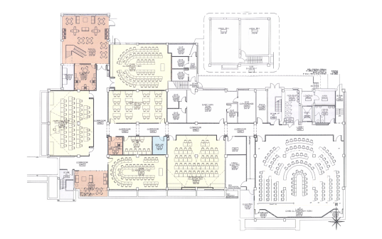
Test 2: Single AP, Multi-Client
One AP, three rooms, 30 clients/room
Mixed bands (⅓ on 2.4 GHz | ⅔ on 5 GHz) + bi-directionality
All clients associated, even if not being tested
Room 1: 20’ from AP
  30 PCs with dongles
Room 2: 45’ from AP
  30 MacBook Pros
Room 3: 55’ from AP
  30 PCs with dongles
All rooms, 90 clients across
all 3 rooms simultaneously
2
1
AP
3
Center of room
30 evenly distributed clients

Slide 19
Single AP, Multi-Client, Room 1
BI-DIRECTIONAL
TCP THROUGHPUT
1 AP, 1 ROOM, 30 CLIENTS
SHORT DISTANCE
206
Mbps
183
180
20’ (3m)
128
99
Ruckus
7982
Aruba
135
Cisco
3602i
Aerohive
330
Meraki
24

Slide 20
Single AP, Multi-Client, Room 2
BI-DIRECTIONAL
TCP THROUGHPUT
1 AP, 1 ROOM, 30 CLIENTS
MEDIUM DISTANCE
143
Mbps
119
45’ (15m)
71
71
18
Ruckus
7982
Aruba
135
Cisco
3602i
Aerohive
330
Meraki
24

Slide 21
Single AP, Multi-Client, Room 3
BI-DIRECTIONAL
TCP THROUGHPUT
1 AP, 1 ROOM, 30 CLIENTS
LONG DISTANCE
91
Mbps
60’ (18m)
63
31
25
Ruckus
7982
0
Aruba
135
Cisco
3602i
Aerohive
330
Meraki
24

Slide 22
High Density TCP Performance
BI-DIRECTIONAL
TCP THROUGHPUT
1 AP, 3 ROOMS, 90 CLIENTS
ALL DISTANCES
130
Mbps
77
56
39
Ruckus
7982
0
Aruba
135
Cisco
3602i
Aerohive
330
Meraki
24

Slide 23
Test 3: Multiple APs, Multiple Clients
6 APs, 4 rooms
Each classrooms has an AP, 30 clients (120 clients total)
  Clients: ⅓ on 2.4 GHz, ⅔ on 5 GHz
2 other APs in nearby rooms
  Features turned on:
    Auto channel selection
    Client load balancing
    Airtime fairness
  Room 1: 30 PCs w/ Netgear dongles
  Room 2: 24 MacBooks, 6 Dell laptops
  Room 3: 30 PCs w/ Netgear dongles
  Room 4: 30 PCs w/ Linksys dongles
Test with and without nearby rogue Wi-Fi network (interferer)
  Two PCs running iPerf for the duration of the testing
2
R
AP
1
AP
4
AP
AP
AP
AP
3
Classrooms

Slide 24
Multiple APs, Multiple Clients
BI-DIRECTIONAL
TCP THROUGHPUT
6 APs, 120 CLIENTS
NO NEIGHBOR APS
562
Mbps
480
24 clients uploading
(8 on 2.4 and 16 on 5GHz)
96 clients downloading
(32 on 2.4 and 64 on 5 GHz)
378
330
324
Ruckus
7982
Cisco
3602i
Aruba
135
Meraki
24
Aerohive
330

Slide 25
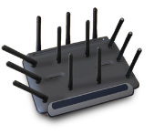
Multiple APs, Multiple Clients
BI-DIRECTIONAL
TCP THROUGHPUT
6 APs, 120 CLIENTS
WITH NEIGHBOR AP
570
Mbps
441
374
369
324
ROGUE AP
Dual-band AP with two 2.4GHz laptops associated client transmitting data back and forth broadcasting on same channel (6) and 5 GHz radio broadcasting
with no clients
Ruckus
7982
Aerohive
330
Meraki
24
Cisco
3602i
Aruba
135

Slide 26
Summary
Three-stream 802.11n won’t deliver
what vendors promise
Rigorous testing methodology is essential
  Single AP----client testing doesn’t give full picture
  Multi-AP-----multi client tests reflect more real world
  Hundreds of tests required to determine the truth
  Designing repeatable tests is essential
  Ensuring all SSIDs are the same across vendors
  Getting PC clients associated
(Dis)advantages of cloud controller
The ZF 7982 is a fancy piece of kit
  Consistently very consistent and high performing

Slide 27









The Syracuse Test Team

