Slide 1
Ruckus Ready Partner Program
Education Requirements Guide
November 1, 2017

Slide 2

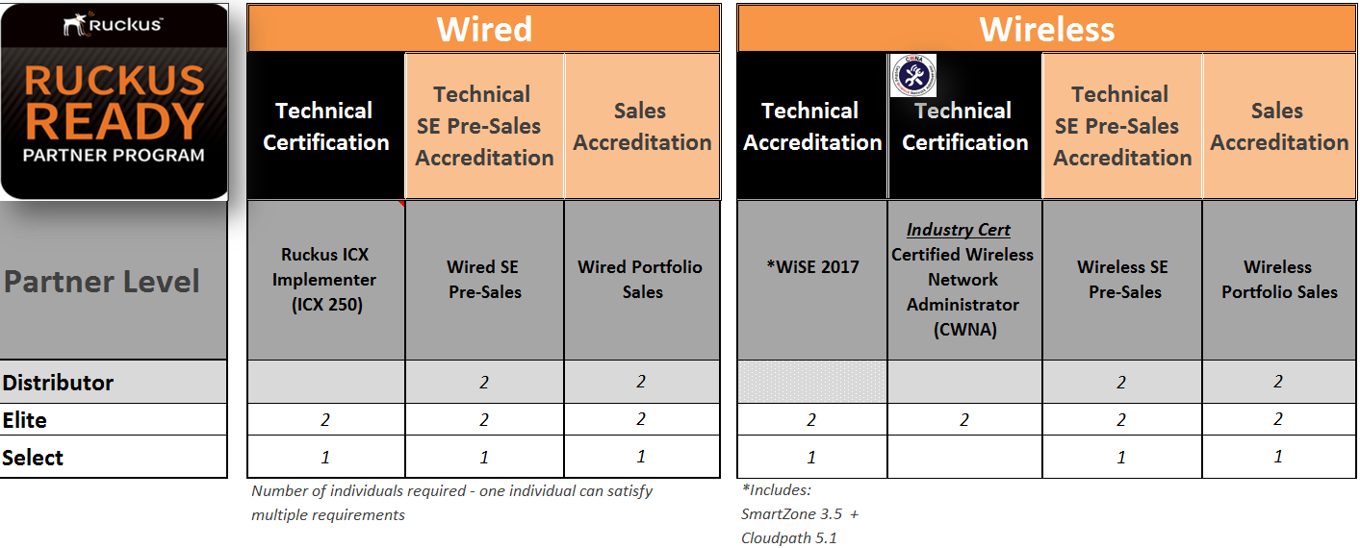
Ruckus Ready Partner Program Education Requirements
Refer to the “Ruckus Ready FAQ” on the Partner Portal to address common partner training questions.

Slide 3
Ruckus Ready Partner Program Curriculum Map eLeaning Course Links Provided
Technical Product Training
SE Pre-Sales Portfolio Training
Sales Portfolio
Training
Wired
Track
Ruckus ICX 250 Implementer
(6hrs 12min)
Wired Portfolio SE Pre-Sales
(1hr)
Wired Portfolio
Sales
(44min)
Exam via Certifior
WiSE 2017
RASZA 200 - Ruckus Associate SmartZone Admin
SmartZone 3.5
3hrs 39min
CPA 200 - Ruckus Cloudpath Security and Policy Platform Management Cloudpath 5.1
7hrs 12min
CWNA® - Certified Wireless Network Administrator
Exam via CWNP: 90min
Wireless Portfolio SE Pre-Sales
(23 min)
Wireless Portfolio Sales
(38min)
Wireless
Track

Slide 4
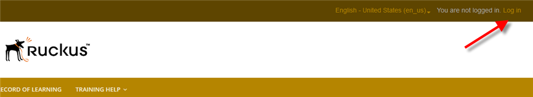
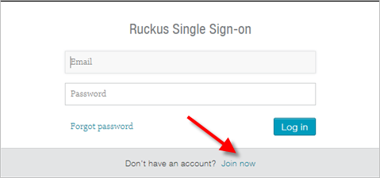
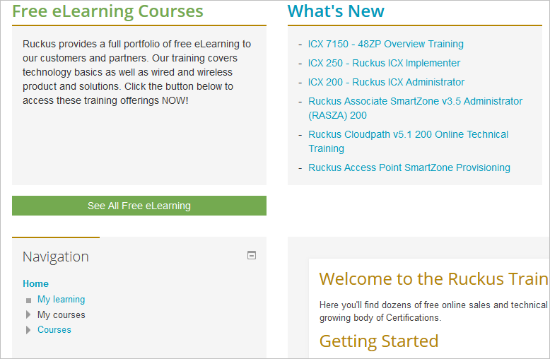
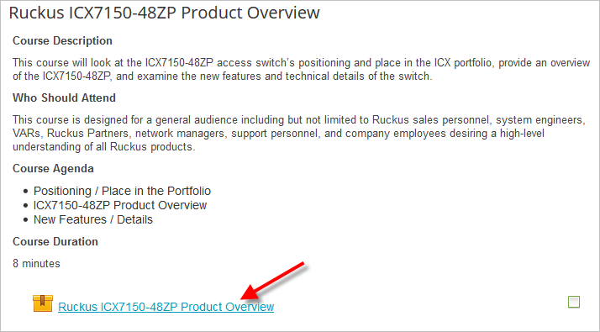
Logging in to the Ruckus Training Portal
In order to use the Ruckus Training Portal you must first create an account either on our Partner Portal (if your company is already, or plans to become, a Ruckus channel partner) or through our Support Portal.
To get started:
Point your browser to https://training.ruckuswireless.com/
Click the Log In link in the upper right corner
Click Join now to create a new Support Portal account. . Follow the on-screen instructions. If your company is, or plans to become a Ruckus Channel Partner: please visit https://partners.ruckuswireless.com/apply to request a Partner Portal account
Once your account has been verified, you will be able to log into the training portal home page. Use the following to locate the class you are interested in.
Once you have located your desired course, click on it and follow on-screen instructions.
2
3
4
5

Slide 5
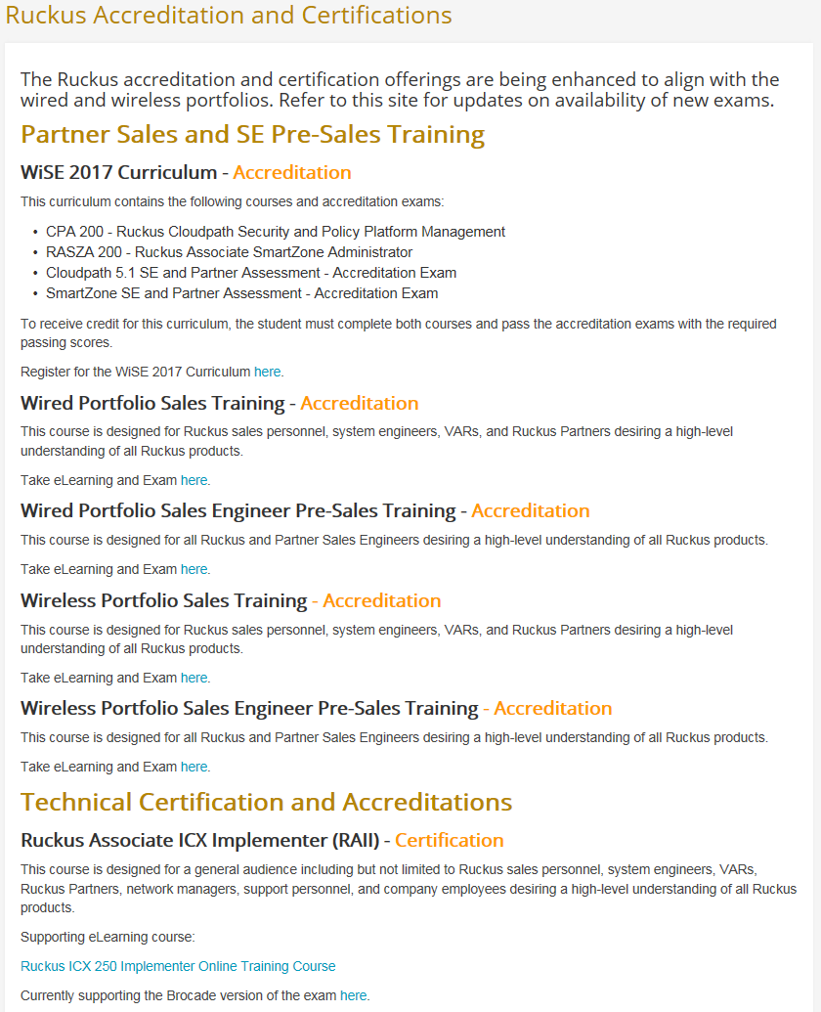
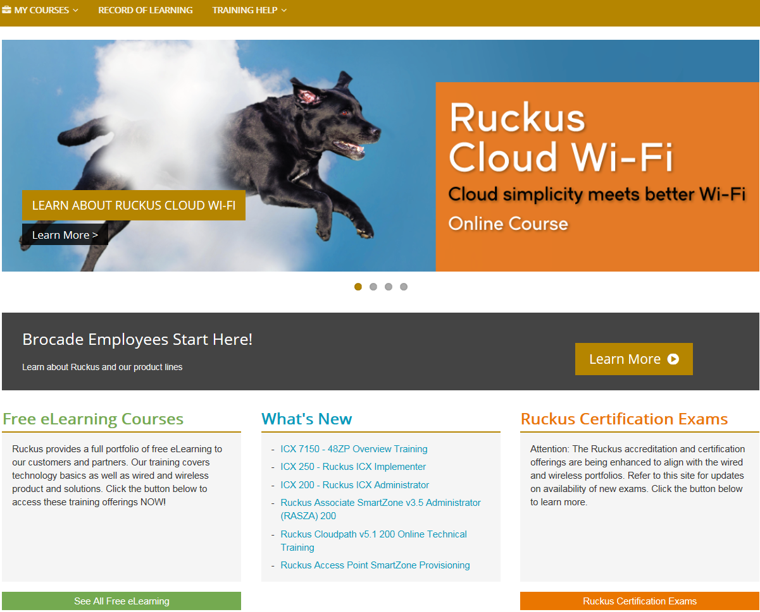
Locating Required Courses on the Training Portal https://training.ruckuswireless.com/
Direct link to Accreditation and Certification page: https://training.ruckuswireless.com/mod/page/view.php?id=848
This page is the ONE page that contains links to all of the partner required training courses

Slide 6
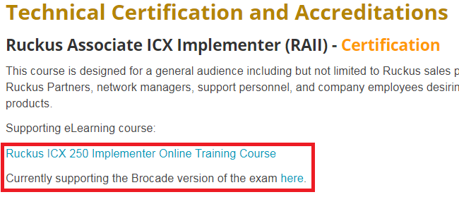
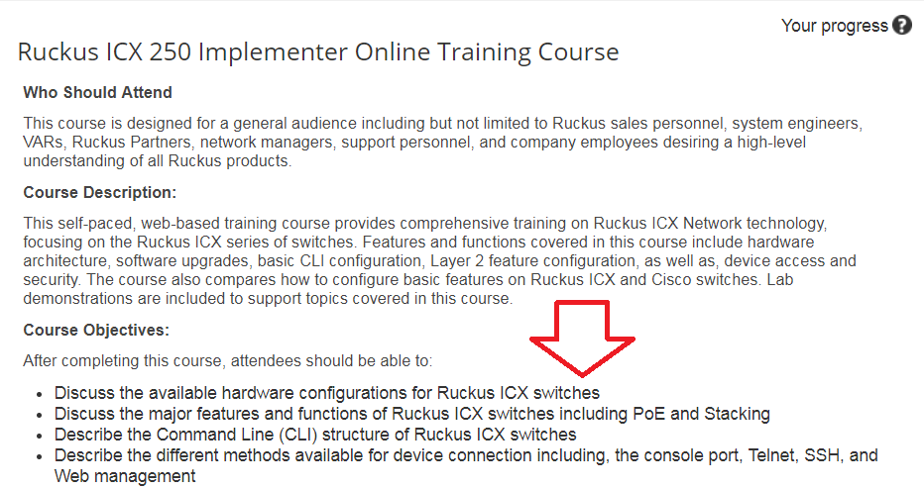

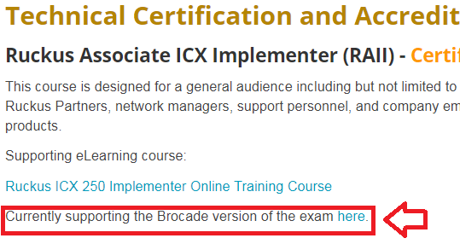
Taking Ruckus ICX 250 Implementer Course
The Ruckus ICX 250 course has twelve (12) modules:
Click on “Ruckus ICX 250 Implementer Online Training Course
Complete all twelve (12) modules
Go back to course listing and click on exam
1
2
Ruckus Certification Exam page
3

Slide 7
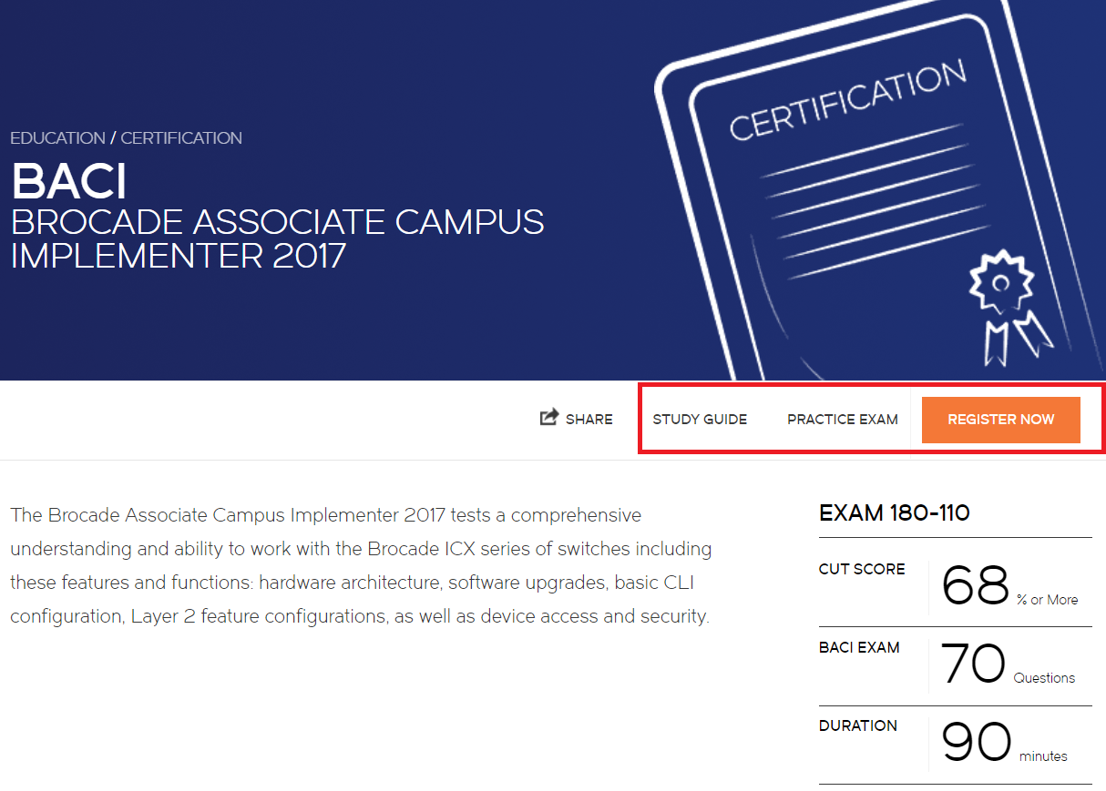
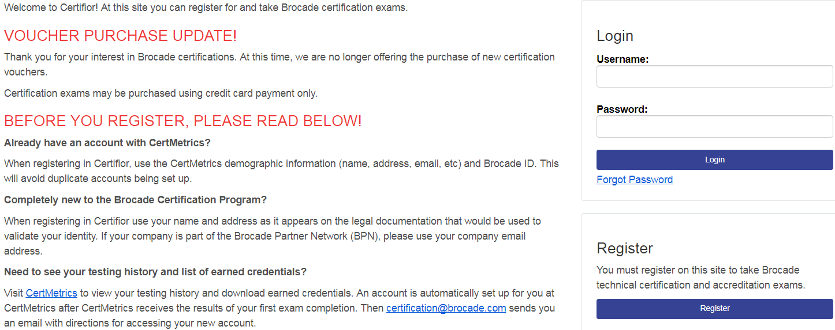
Taking Ruckus ICX 250 Implementer Certification
Exam process subject to change in early 2018
2
The Ruckus ICX 250 exam:
Click on exam
The Brocade certification page will open
  Review the study guide and take a practice exam
Select “Register Now”. This will take you to a login page for Certifior our proctoring exam system. Follow the instructions to register for the exam
Upon passing the proctored exam, your passing credential will automatically feed into our system and your certification will appear in Salesforce.com
1
Ruckus Certification Exam page
Click on “Currently supporting the Brocade version of the exam”
3

Slide 8
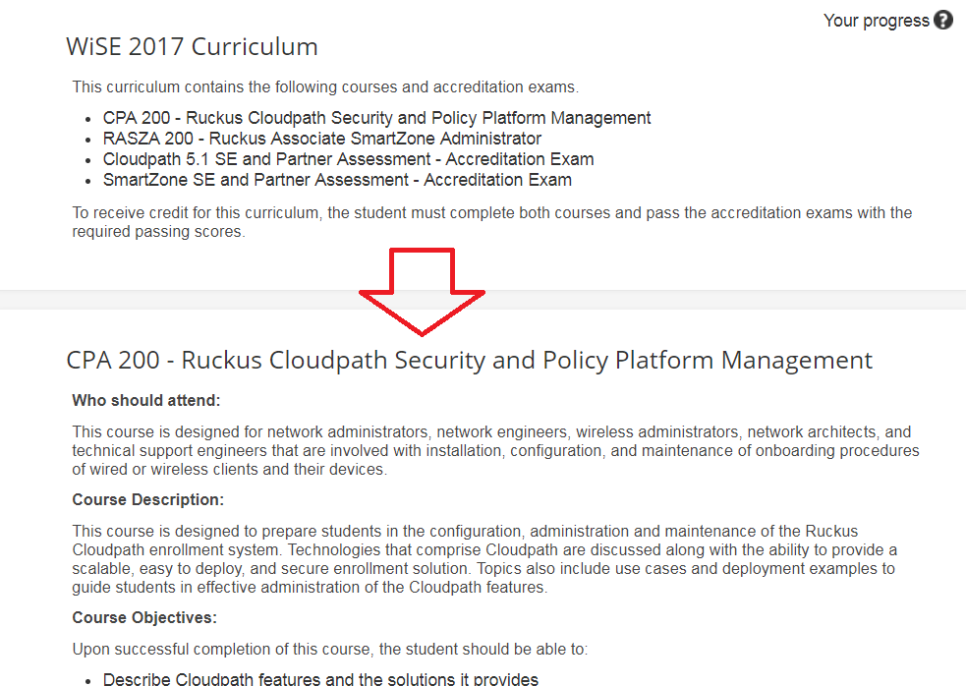
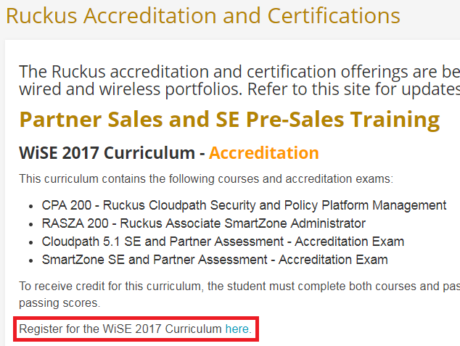
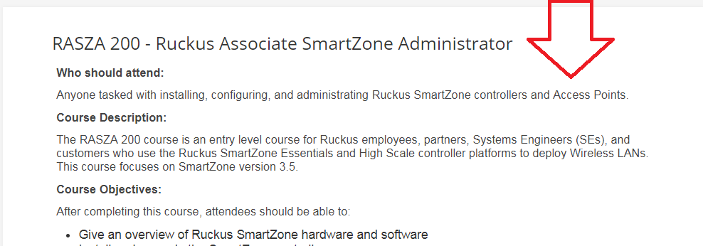
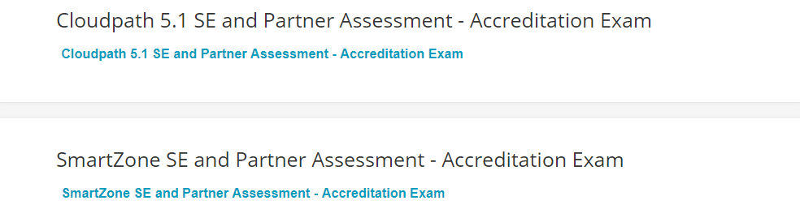
Taking WiSE 2017 Course
The WiSE 2017 course has four (4) components:
Complete CPA 200 which includes fifteen (15) modules
Complete RASZA 200 which includes seventeen (17) modules
Complete Cloudpath 5.1 assessment exam
Complete SmartZone assessment exam
1
Ruckus Certification Exam page
Click on “Register for the WiSE 2017 Curriculum here”
2
3
4

Slide 9
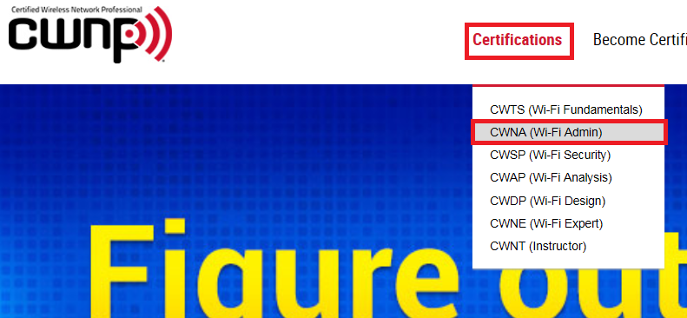
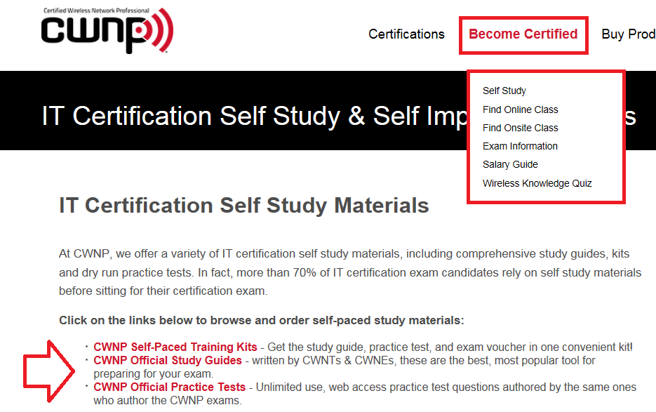
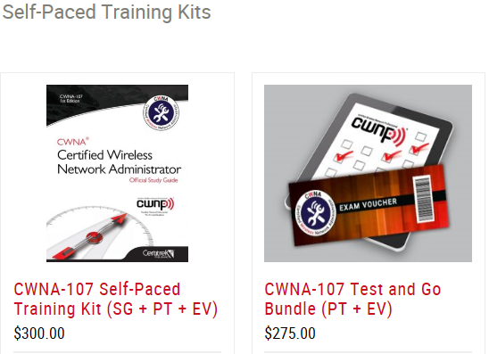
Taking CWNA Industry Certification
MDF can be used to pay for training and certification exam
The CWNA certification is hosted via the industry vendor CWNP:
There are a number of ways to get ready for our IT certification exams, including self-study, eLearning, practice tests, and live training through a CWNP Authorized Learning Center. Learn more
You can select your path to take the exam – each has a different cost:
  Self paced
  Live training
Upon passing the CWNA certification exam, email a copy to Jennifer Judy jjudy@brocade.com
  Due to divestiture and system alignment – this certification will not appear in Salesforce.com until early 2018
1
4
3
2

Slide 10
Course Details
MDF can be used to pay for training and certification/accreditation exams
Course | Instructor Led or Virtual Led | eLearning | Estimated Course Cost | Years Valid | Courses that grandfather to new requirement | Accreditation and Certification Exam Cost
ICX 250 – Ruckus ICX Implementer | N/A | 4.5 hours | ILT/vLT – NA eLearning - Free | 3 years | Brocade BPIPA | $150 – proctored exam
Wired SE Pre-Sales | N/A | 1 hour | ILT/vLT – NA eLearning - Free | 1 year | None | No Cost
Wired Sales | N/A | 44 min | ILT/vLT – NA eLearning - Free | 1 year | None | No Cost
Total Time: |  | 6 hours
WiSE 2017 | N/A | 16 hours | ILT/vLT – NA eLearning - Free | 3 years | WiSE Level 1 will satisfy the Smartzone module in the curriculum | No cost through Jan 31, 2018. Feb 1, 2018 cost $50
CWNA (Industry Certification)* | 5 days | 10 hours | Refer to CWNP site | 3 years | None | Varies by self paced or Live. Refer to CWNP site
Wireless SE Pre-Sales | N/A | 23 min | ILT/vLT – NA eLearning - Free | 1 year | None | No Cost
Wireless Sales | N/A | 38 min | ILT/vLT – NA eLearning - Free | 1 year | None | No Cost
Total Time: |  | 27 hours
Wired
Wireless
*Target to have CWNA eLearning course on Ruckus Training Portal in early 2018
Notes:
MSRP for wired or wireless vILT or ILT ATP delivery in Tier 1 countries are:
$800/day for a single seat in public course (vLT or ILT)
$6,000/day for private delivery up to 12 students (vLT or ILT)

Slide 11
Sales & Pre-Sales Course Descriptions
Wired Portfolio Sales Training
Who Should Attend:
This course is designed for Ruckus sales personnel, system engineers, VARs, and Ruckus Partners desiring a high-level understanding of all Ruckus products.
Course Description:
This course has the following three modules:
Wired Infrastructure – Customer Challenges
Wired Infrastructure – Ruckus ICX Switching Overview
Wired Infrastructure – Intro to Campus Fabric
Delivery Options: Self-paced online training
Duration: 44 minutes
Wired Portfolio Sales Engineer Pre-Sales Training
Who Should Attend:
This course is designed for all Ruckus and Partner Sales Engineers desiring a high-level understanding of all Ruckus products.
Course Description:
In this training module you will learn about common customer challenges and how the Ruckus ICX product family addresses these customer pain points, review the entire portfolio of ICX switches and their features, discuss how you can WIN with Ruckus solutions, highlight our competitive differentiators, and look at resources for more information and help.
Delivery Options: Self-paced online training
Duration: 59 minutes
Wireless Portfolio Sales Training
Who Should Attend:
This course is designed for Ruckus sales personnel, system engineers, VARs, and Ruckus Partners desiring a high-level understanding of all Ruckus products.
Course Description:
In this training module you will learn about common wireless industry trends and challenges, and overview of the Ruckus wireless portfolio and how to win with Ruckus wireless.
Delivery Options: Self-paced online training
Duration: 38 minutes
Wireless Portfolio Sales Engineer Pre-Sales Training
Course Description
This self-paced, web-based training course provides an overview of the Wi-Fi industry and how Ruckus solutions fit into these requirements, an overview of the Ruckus wireless portfolio, how to win with Ruckus solutions, understanding the Ruckus competitive differentiators and real life use cases.
Who Should Attend:
This course is designed for a general audience including but not limited to Ruckus sales personnel, system engineers, VARs, Ruckus Partners, network managers, support personnel, and company employees desiring a high-level understanding of all Ruckus products.
Course Objectives:
After completing this course, attendees will:
Become familiar with the industry and how we fit
Understand the Ruckus wireless Portfolio Overview
Know how to win with Ruckus solutions
Understand Competitive Differentiators
Become familiar with Real life Use Cases
Suggested Pre-Requisites:
Introduction To Ruckus Products
Layer 2 protocols
Network management protocols and function
Ruckus IP hardware and its designated roles in a network
Duration: 23:30 minutes

Slide 12
Wired Technical Course Descriptions
Ruckus ICX 250 Implementer Online Training Course
Who Should Attend
This course is designed for a general audience including but not limited to Ruckus sales personnel, system engineers, VARs, Ruckus Partners, network managers, support personnel, and company employees desiring a high-level understanding of all Ruckus products.
Course Description:
This self-paced, web-based training course provides comprehensive training on Ruckus ICX Network technology, focusing on the Ruckus ICX series of switches. Features and functions covered in this course include hardware architecture, software upgrades, basic CLI configuration, Layer 2 feature configuration, as well as, device access and security. The course also compares how to configure basic features on Ruckus ICX and Cisco switches. Lab demonstrations are included to support topics covered in this course.
Course Objectives:
After completing this course, attendees should be able to:
Discuss the available hardware configurations for Ruckus ICX switches
Discuss the major features and functions of Ruckus ICX switches including PoE and Stacking
Describe the Command Line (CLI) structure of Ruckus ICX switches
Describe the different methods available for device connection including, the console port, Telnet, SSH, and Web management
Use Authentication, Authorization, and Accounting (AAA) to secure a Ruckus ICX switch
Configure interface settings including, name, IP address, speed and duplex
Configure Virtual LANs (VLANs) and Link Aggregation Groups (LAGs)
Configure Layer 2 redundancy features including, Spanning Tree Protocol (STP) and Multi-Chassis Trunking (MCT)
Describe the software upgrade process for Ruckus ICX switches
Compare how to configure basic features on Ruckus ICX and Cisco switches
Delivery Options: Self-paced online training
Duration for all modules: 6 hours 12 minutes
Prerequisites:
Layer 2 protocols
Network management protocols and function
Ruckus IP hardware and its designated roles in a network

Slide 13
Wireless Technical Course Descriptions
WiSE 2017 Curriculum
This curriculum contains the following courses and accreditation exams.
CPA 200 - Ruckus Cloudpath Security and Policy Platform Management
RASZA 200 - Ruckus Associate SmartZone Administrator
Cloudpath 5.1 SE and Partner Assessment - Accreditation Exam
SmartZone SE and Partner Assessment - Accreditation Exam
*To receive credit for this curriculum, the student must complete both courses and pass the accreditation exams with the required passing scores.
RASZA 200 - Ruckus Associate SmartZone Administrator
Who should attend:
Anyone tasked with installing, configuring, and administrating Ruckus SmartZone controllers and Access Points.
Course Description:
The RASZA 200 course is an entry level course for Ruckus employees, partners, Systems Engineers (SEs), and customers who use the Ruckus SmartZone Essentials and High Scale controller platforms to deploy Wireless LANs. This course focuses on SmartZone version 3.5.
Course Objectives:
After completing this course, attendees should be able to:
Give an overview of Ruckus SmartZone hardware and software
Install and upgrade the SmartZone controller
Explain the architecture of the SmartZone controller
Configure Domains and Zones / Create and assign Administrator accounts and roles
Successfully register Ruckus Access Points to the controller
Perform advanced Access Point configuration
Create Basic WLANs / Edit WLAN advanced settings
Create WLAN Groups, schedules and VLAN Pools
Manage WLAN devices / Authenticate WLAN users with AAA
Deploy authentication portals / Authenticate guests using Guest Passes
Manage clustering and fault tolerance
Delivery Options: Self-paced online training
Duration for all modules: Approximately 3 hours 39 minutes
Prerequisites:
Before taking this course, students should have completed the following courses:
Introduction to Ruckus Products
LAN/WLAN Fundamentals
CPA 200 - Ruckus Cloudpath Security and Policy Platform Management
Who should attend:
This course is designed for network administrators, network engineers, wireless administrators, network architects, and technical support engineers that are involved with installation, configuration, and maintenance of onboarding procedures of wired or wireless clients and their devices.
Course Description:
This course is designed to prepare students in the configuration, administration and maintenance of the Ruckus Cloudpath enrollment system. Technologies that comprise Cloudpath are discussed along with the ability to provide a scalable, easy to deploy, and secure enrollment solution. Topics also include use cases and deployment examples to guide students in effective administration of the Cloudpath features.
Course Objectives:
Upon successful completion of this course, the student should be able to:
Describe Cloudpath features and the solutions it provides
Discuss purpose and roll of certificates and PKI protocols in the Cloudpath solution
Discuss the creation of workflows for company managed, BYOD, and guest access
Configure various Network Access Control (NAC) policies for client, device, and access types providing unique policy enforcement
Deploy onboarding workflows at multi-location environments
Describe Cloudpath server clustering
Delivery Options: Self-paced online training
Duration for all modules: Approximately 7.2 hours
Prerequisites:
Before taking this course, students should have working knowledge of:
Ruckus Wi-Fi Essentials course
Ruckus Cloudpath online training course
Basic knowledge of the Wi-Fi onboarding process
Basic knowledge of authentication protocols

Slide 14
Wireless Technical Course Descriptions
Certified Wireless Network Administrator
What it takes to become a CWNA:
The CWNA certification is a foundational level wireless LAN certification for the CWNP Program. To earn a CWNA certification, you must take the CWNA exam at a Pearson Vue Testing Center and pass with a 70% or higher. Instructors must pass with a 80% or higher. However you choose to prepare for the CWNA exam, you should start with the exam objectives, which cover the full list of skills tested on the exam. The CWNA certification is valid for three (3) years. To recertify, pass one of the professional level certifications exams (CWSP,CWDP, CWAP) BEFORE your CWNA expires. By doing so, the CWNA will be renewed for another three (3) years. Or retake the current version of the CWNA exam.
Main Areas Covered by CWNA:
  Radio Frequency (RF) Technologies
  Antenna Concepts
  Wireless LAN Hardware and Software
  Network Design, Installation, and Management
  Wireless Standards and Organizations
  802.11 Network Architecture
  Wireless LAN Security
  Troubleshooting
  How to Perform Site Surveys
  Exam Objectives (CWNA-106)
  Exam Objectives (CWNA-107)
CWNA Exam Summary:
  Exam Number: CWNA-106 (Last registration date is October 1, 2017 - exams can be scheduled through December 31, 2017)
  New Exam Number: CWNA-107 (First registration date is October 1, 2017)
Everything you need to prepare is right here:
  Official CWNA Certification Self Study Kit (including a Study Guide, Practice Test and Exam Voucher)
  Wi-Fi Administration eLearning
  Live Training Wireless Network Certification Class

Slide 15







In Development
Vertical Sales Training
Now available
MDU
Smart City
Higher Education
Now available
Security: Cloudpath
Primary Education
Hospitality
Large Public Venues

Slide 16
Thank You
Training Questions Contact:
Jennifer Judy
Senior Manager, WW Channel Enablement and Training jjudy@brocade.com

